Slide 1
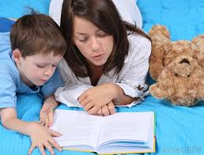
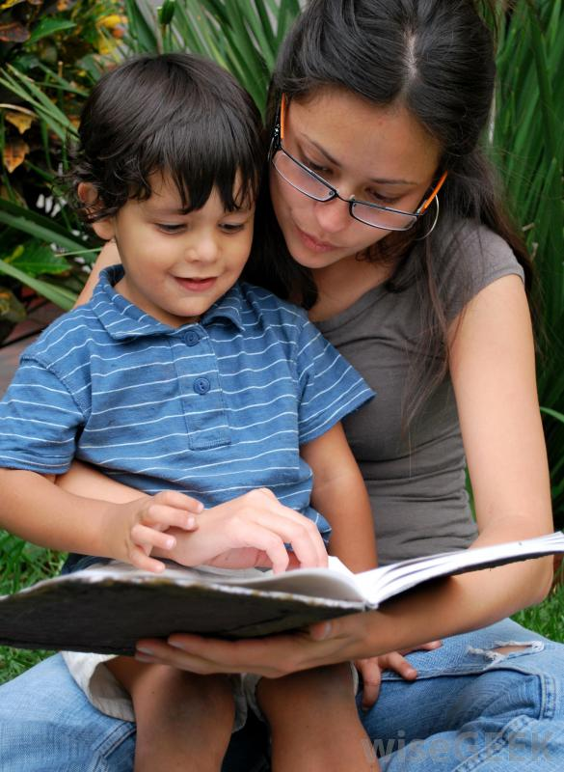
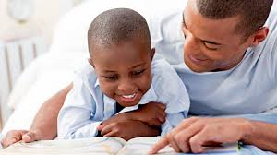
Literacy & Math Strategies to Support Your Child at Home
The Sylvia Rosenauer School Team:
Roseanne Carello, Donna DiLorenzo, Donna Donner, Donna Mollica, Brittney Penson
T

Slide 2
Did you know that students spend only about 13% of a calendar year in school?
This is why we need your help!
Notes:
Give statistic on the percentage of time students actually spend in school during a calendar year.

Slide 3
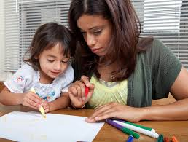
Parents as “Coaches”
Today we want to provide you with the necessary tools to take on that role!
We want to give you ideas of “what can be happening” at home.
As a coach, you will want to set aside time to do “home activities” with your child.
Monitor your child’s progress and share successes with his or her teacher.

Slide 4
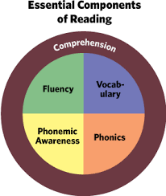
Successful Reading Instruction
Fluency: the ability to read quickly and naturally
Vocabulary: the ability to learn new words and build their knowledge of what words mean
Phonemic Awareness: the ability for a child to understand that spoken words are made up of separate small sounds
Phonics: the ability to learn and use letter-sound relationships and be able to recognize words when they see them
Comprehension: the ability to understand what is read

Slide 5
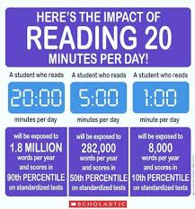
What’s one of the best ways to help?
Read to your child daily

Slide 6
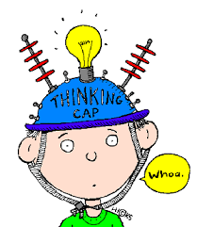
Sharing Books or Reading Aloud:
Supports Comprehension
The single most important activity for building the knowledge required for success in reading!
When sharing a book with your child:
Show your child how books work.
As you read, have him point out the names of authors and illustrators and tell what they do.
Have him show you where you should start reading on a page.
Help your child make connections between print and pictures as you read.

Slide 7
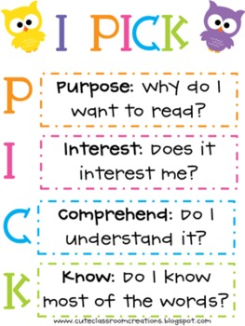
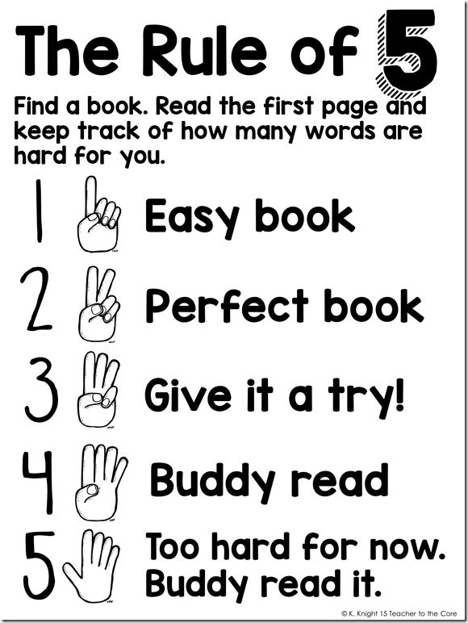
How to Choose a “Just Right” Book

Slide 8
Comprehension Strategies
While I’m reading my brain is making sense of the text because I’m using strategies.
Predicting “What’s going to happen next?” I think ____ because ____. | Visualizing Creating pictures in your mind based on the text. Think: 5 senses | Summarizing Our brains can sum up what happened in the story or the information that was given.

Slide 9
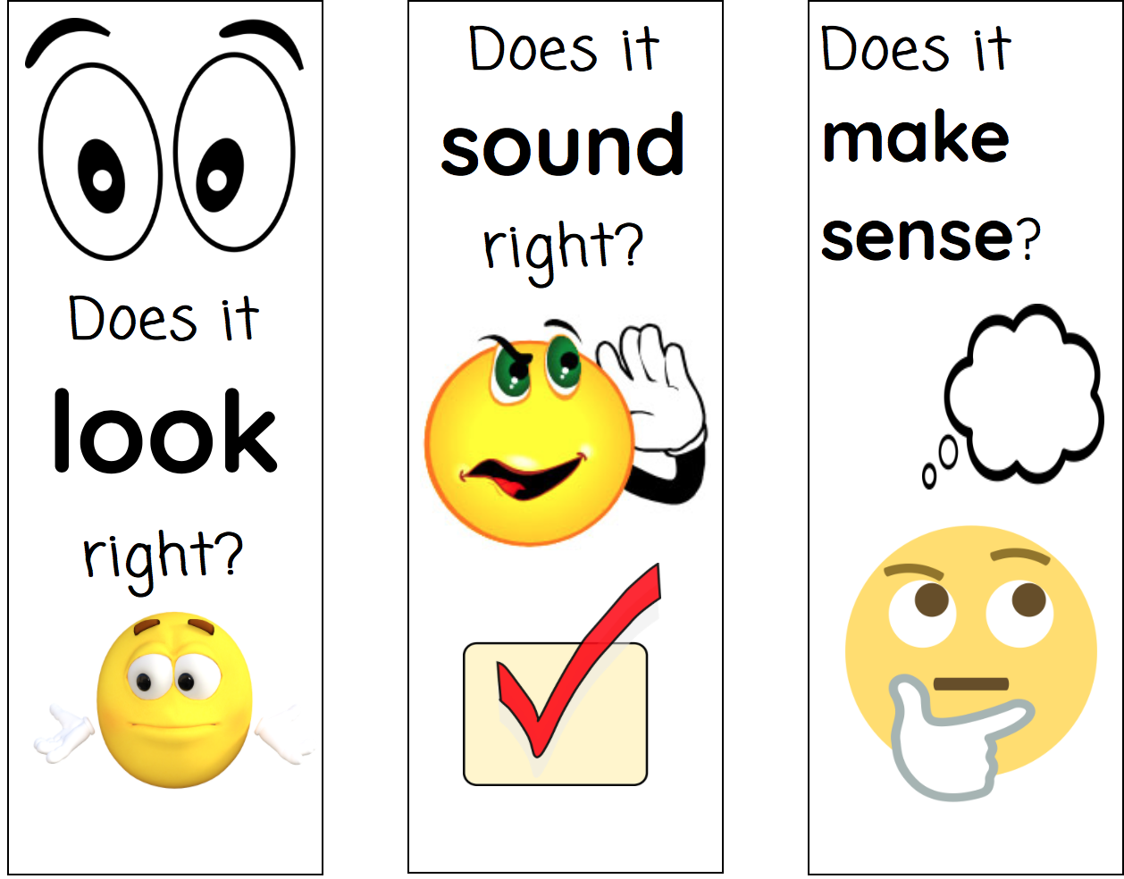
Questions to ask ALL Readers...
three self monitoring questions:
Children need to learn how to internalize these questions

Slide 10
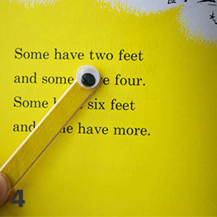
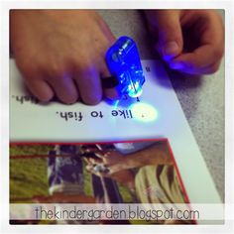
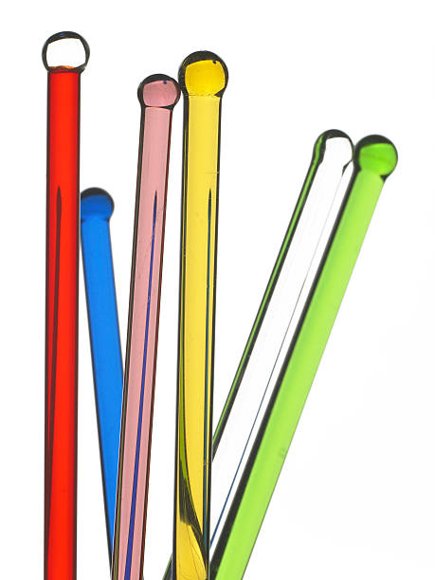
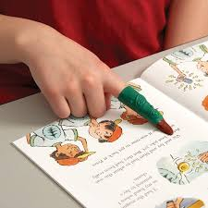
Kindergarten Strategies
There are three ways to read a book:
Preview the book and spend time talking about the pictures
Read to your child, read with your child, listen to your child read
Think aloud: “I wonder why…” “I think he’s going to____ because…”
Use the pictures to help with unknown words
Students point to the words: Use fun tools!
Read the words
Read the pictures
Retell the story
It is ok to reread books over, and over, and over again!!

Slide 11
First Grade Strategies
When your child gets stuck on a word, try phrases like:
Check the picture to help you
Look at all the parts of the word
Try it two ways
Get a running start
Get your mouth ready

Slide 12
Second Grade Strategies
Tricky Words
Comprehension
Think about what is happening in the story
Look through the word, part-by-part an-i-mal
Look for a word inside a word welcome fall plane
Look for vowel teams: seat goat
Reread!
Stop, Think, Retell
Use stop and jots to remember ideas
Learn a lesson: “What does the author want to teach me?”
Figure out what words mean
Ex. Uncle Jake was so burly that he had the treehouse built in two hours.

Slide 13
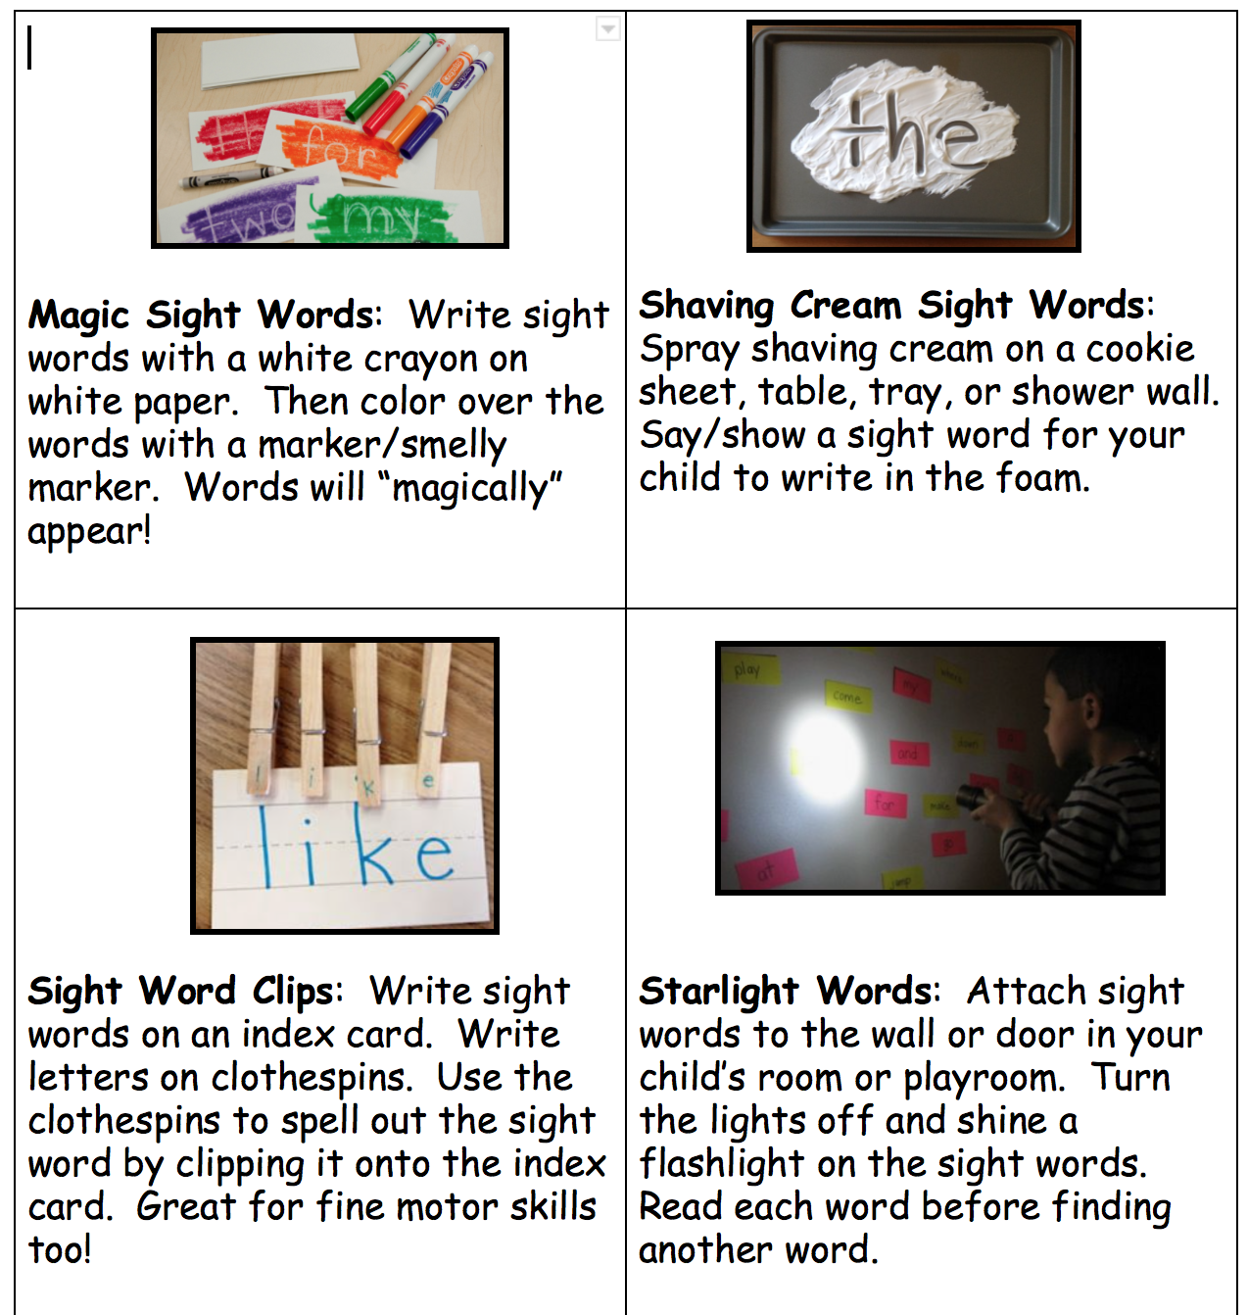
8 Really Fun Sight Word Activities to do at home!

Slide 14
Read...Read...Read...
The Ocean County Library has tons of free resources on their webpage.
Share stories together as a family being read aloud either in English or in Spanish using TumbleBooks. http://asp.tumblebooks.com/BooksList.aspx?categoryID=8
Learn English Online for free through the library’s free language classes. You can gain access to Rosetta Stone, Mango Languages, and Pronunciator databases. All you need is a FREE library card.

Slide 15
Want to Read Better? Read More!!

Slide 16
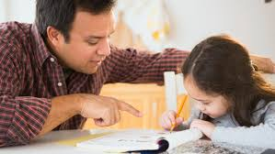
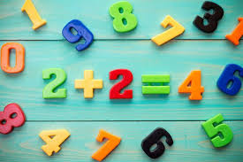
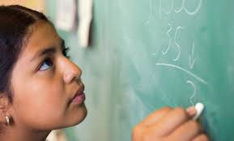
Using Math at Home
Key concepts
What to work on How to make math fun

Slide 17
Math Key Concepts : https://www.jacksonsd.org/Page/7928
K
Compare, Count, & Write numbers 0-20
Understand Addition & Subtraction
Identify, Compare, and Describe Shapes
Classify and Count Data
1 - Solve Addition & Subtraction problems - Represent and Interpret Data - Understand Place Value, Compare 2-Digit Numbers - Add Tens and Ones - Shapes, Time, Measurement
2
Fluently Add and Subtract within 100
Solve Addition and Subtraction Word Problems
Time, Measurement, Shapes, and Money
Graphs and Data

Slide 18
Math Key Concepts
3
Understand Multiplication & Division within 100
Understand Addition & Subtraction through 1000
Understanding fractions as numbers, equivalence & comparing
Understand perimeter and area and relate addition and multiplication principles
Problem solving, data, & three dimensional shapes
4
-Generalizing place value
-Addition & subtraction of multi digit whole numbers, decimals, and fractions - Multiplication & division of multi digit whole numbers, decimals and fractions
- Algebra analyzing patterns
-Factors and multiples - Comparing decimals - Finding equivalent measures, using geometric measures
5
Fluently add, subtract, multiply, and divide whole numbers, decimals, and fractions
Using models to add, subtract, multiply, and divide decimals and fractions
Understand and find volume
Graphs coordinates and analyze data
Algebra:write and interpret numerical expressions
Convert measurements
Classify 2 dimensional figures

Slide 19
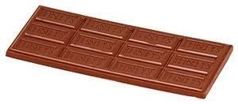
Using Math Talk & Real World Situations
Math at Home: - Have to order pizza for family pizza night how many pizzas should I order? - Breaking something into equal shares. - If I have 10 pieces candy and 8 friends, do I have enough pieces to give each one a piece?
-Use regular playing cards as flash cards to practice math facts
-Hershey bar fraction fun
-Make shopping wish lists
Engage in their classroom learning: - Help your child with their homework and ask them to explain certain parts to you. - Pretend like you don’t know the answer and see if they can teach it to you.
-Use the Pearson online text for help with homework or use the Bounce Page app

Slide 20
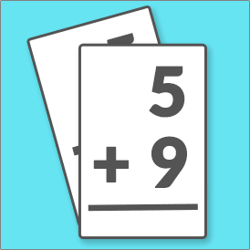
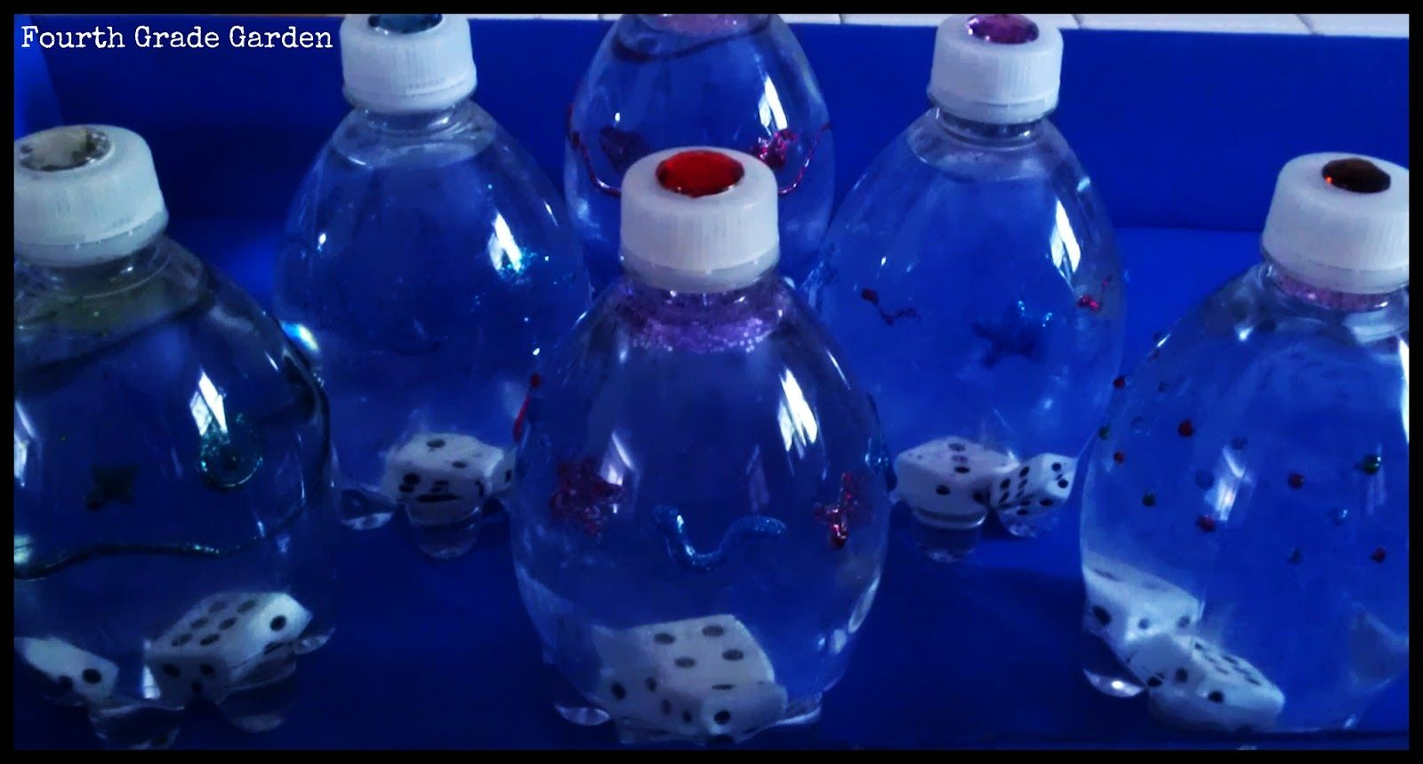
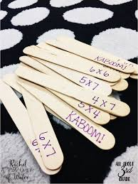
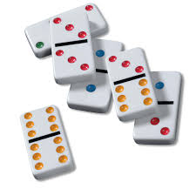
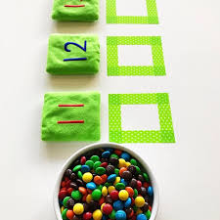
At Home Math Ideas
Math Water with Dice and Glitter
Math Water with Dice and Glitter
Flashcards
Math Water with Dice and Glitter
Popsicle Stick Math Facts
Dominoes
Counting with food

Slide 21
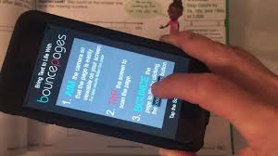
Envision 2.0
All students have an online account
Log into Program using student district email & Holman Home page “For Parents & Students” Tab
Online student Text
Games
Learning Videos to Reteach lesson
Bounce Pages App

Slide 22
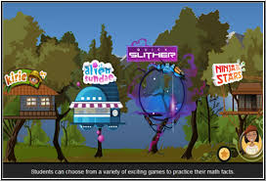
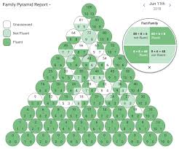
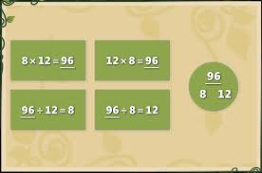
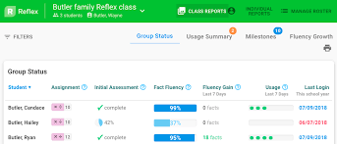

Slide 23
Math Apps and Websites
https://www.symbaloo.com/mix/rosenauerelementary
Math Websites
www.xtramath.org
www.mathplayground.com
www.mathgametime.com
www.funbrain.com
www.abcya.com
www.starfall.com
Math Apps
Splash Math Animal 1st Grade Math Games Brainzy Math Bingo Aaah! Math Zombies! Math Ninja Hungry Fish Math Regrouping Top It! (Addition and Subtraction) Sushi Monster

Slide 24
Thank you for coming tonight!
Please feel free to contact us any time.
rfcarello@jacksonsd.org
ddilorenzo@jacksonsd.org
dmollica@jacksonsd.org
ddonner@jacksonsd.org

